Slide 1
Exploring question answering data for a specific domain
Group: 12
Group members:
Marim Amer
Mawada Amer
Youmna Alsayed

Slide 2
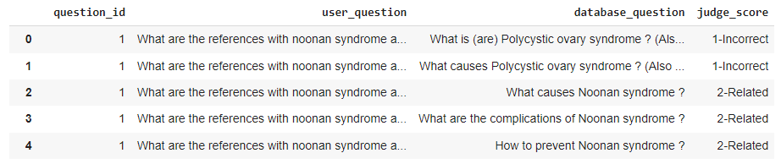
Dataset
Two datasets (Medical Dataset question answers)
MedQuAD Dataset (Three questions)
10 columns (source, URL, Focus, Synonym, Cui, Answer, type, SemanticType, SemanticGroup, and question )
37 question types (treatment, diagnosis, side effects)
paired_questions Dataset (model)
4 columns (question_id, database_question, user_question, and judge_score)
2479 rows

Slide 3
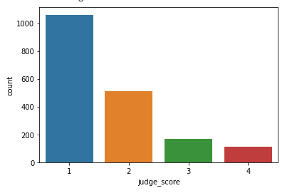
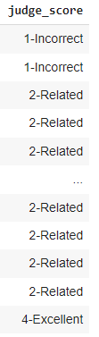
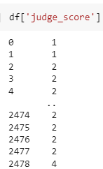
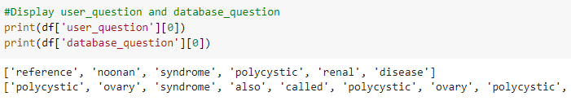
Preprocessing
Clean user_question and database_question columns
Remove stop words, and punctuation.
Remove single letter chars and convert all whitespaces (tabs etc.) to single white space.
All lowercase, tokenization and lemmatization.
Clean judge_score column
Remove all words in the column just we take the number{'1':'Incorrect', '2': 'Related', '3': 'Incomplete', '4': 'Excellent'}
Convert column type into integer.
Imbalanced Data

Slide 4
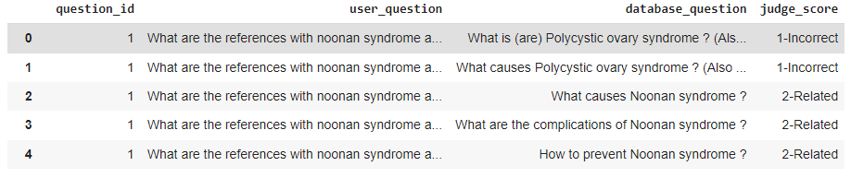
Questions
What are the entailment levels for each question pair? (regression question)
Goal: Input two questions and predict their entailment score to find out how true the question is.
Know us the entailment level between two questions (1: Incorrect, 2: Related, 3: Incomplete, 4: Excellent)
Approach:
Read Data
Preprocessing
Split (Train, Test)
Similarity between pair question
Regression model (DT)
Finally, the regression model gave us the percentage of error = 0.6
Mawada Amer

Slide 5
Questions
What is the qtype of questions? (Predictive question)
Goal: Know question type to add a new question to the main QA data set and to know the best answer to this question
Approach:
Read Data
Preprocessing
Split (Train, Test)
Similarity between pair question
Classification model (DT)
Finally, the classification model recognizes the type of new question to assign a suitable answer to it.
Mawada Amer

Slide 6
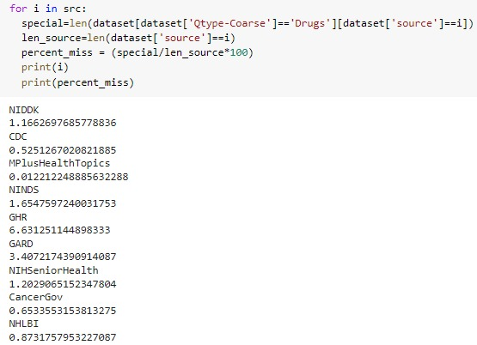
Questions
Is the ratio of questions with qtype-coarse=’Drugs’ from the ’GHR’ source significantly higher than this ratio for all other sources? (Hypothesis test question)
Goal: know where is the source where we can find the most drugs? Or places where the drug is available.
Approach:
Read Data
Preprocessing
Calculate the number of questions with qtype-coarse = ‘drugs’ in ’GHR’ source
Calculate total number of questions in ’GHR’ source
Calculate Drugs ratio for each source= result from 3 / result from 4
Finally, The ’GHR’ Source have a higher ratio than the ratio for all other sources.
Mawada Amer

Slide 7
Similarity
Jaccard Similarity
Levenshtein Similarity
Dice Coefficient
Overlap Coefficient
Cosine Similarity
Marim Amer

Slide 8
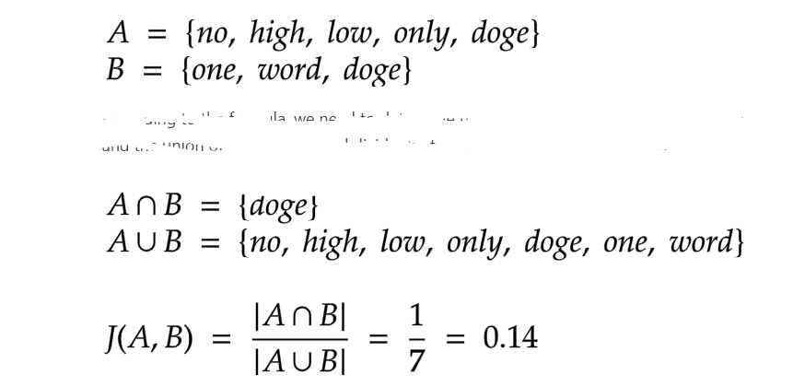
Similarity
Jaccard Similarity
https://datascienceparichay.com/article/jaccard-similarity-python/
Marim Amer

Slide 9
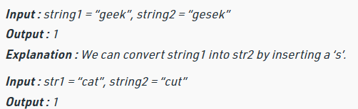
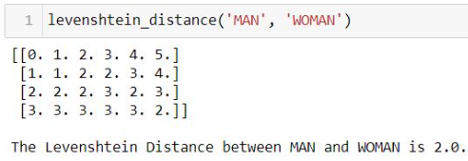
Similarity
Levenshtein Similarity
Marim Amer
Notes:
https://www.geeksforgeeks.org/python-find-the-levenshtein-distance-using-enchant/
https://www.analyticsvidhya.com/blog/2021/02/a-simple-guide-to-metrics-for-calculating-string-similarity/#:~:text=Levenshtein%20distance%20is%20the%20most,transform%20one%20string%20to%20another.

Slide 10


Similarity
Dice Coefficient
where nt is the number of character bigrams found in both strings, nx is the number of bigrams in string x and ny is the number of bigrams in string y.
Notes:
https://en.wikibooks.org/wiki/Algorithm_Implementation/Strings/Dice%27s_coefficient#:~:text=Dice's%20coefficient%20measures%20how%20similar,adjacent%20letters%20in%20the%20string).
https://www.researchgate.net/figure/Example-of-calculating-string-similarity-by-comparing-two-bloom-filters_fig4_318241955

Slide 11


Similarity
Overlap Coefficient
Notes:
http://anhaidgroup.github.io/py_stringmatching/v0.4.1/OverlapCoefficient.html

Slide 12



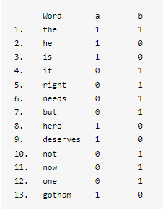
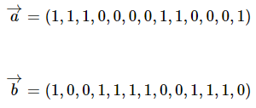

Similarity
Cosine Similarity
Notes:
https://nishtahir.com/fuzzy-string-matching-using-cosine-similarity/

Slide 13
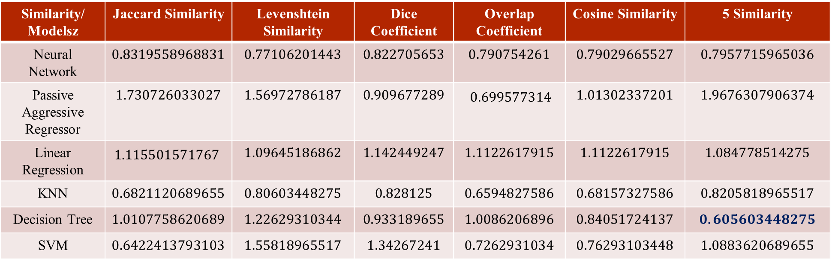
Results
The best result was using a decision tree and using five types of similarity.
Similarity/ Modelsz | Jaccard Similarity | Levenshtein Similarity | Dice Coefficient | Overlap Coefficient | Cosine Similarity | 5 Similarity
Neural Network | $$0.8319558968831$$ | $$0.77106201443$$ | $$0.822705653$$ | $$0.790754261$$ | $$0.79029665527$$ | $$0.7957715965036$$
Passive Aggressive Regressor | $$1.730726033027$$ | $$1.56972786187$$ | $$0.909677289$$ | $$0.699577314$$ | $$1.01302337201$$ | $$1.9676307906374$$
Linear Regression | $$1.115501571767$$ | $$1.09645186862$$ | $$1.142449247$$ | $$1.1122617915$$ | $$1.1122617915$$ | $$1.084778514275$$
KNN | $$0.6821120689655$$ | $$0.80603448275$$ | $$0.828125$$ | $$0.6594827586$$ | $$0.68157327586$$ | $$0.8205818965517$$
Decision Tree | $$1.0107758620689$$ | $$1.22629310344$$ | $$0.933189655$$ | $$1.0086206896$$ | $$0.84051724137$$ | $$0.605603448275$$
SVM | $$0.6422413793103$$ | $$1.55818965517$$ | $$1.34267241$$ | $$0.7262931034$$ | $$0.76293103448$$ | $$1.0883620689655$$
Marim Amer

Slide 14
Random Oversample
Random oversampling duplicates examples from the minority class in the training dataset and can result in overfitting for some models.
Randomly duplicate examples in the minority class.
Random under sampling deletes examples from the majority class and can result in losing information invaluable to a model

